Slide 1
Queen Street
Underground Electrical Project
Christiansted, St. Croix, VI

Slide 2

Queen Street: Underground Impact/Funding
Underground Benefits
System durability/reliability
Aesthetics
Reduced maintenance
Civilian/wildlife safety
Environmental Benefits (post construction)
  Less repairs/emissions
  Less congestion within area
Fewer disruptions
Minimized customer push back
This is a FEMA funded project, which means it is paid for by the federal government.
Notes:
At some point during electrician-related scope of work we recognize that you may directly or indirectly interact with personal from different departments within the Authority. The Authority’s support department includes the Customer Service Department, Design & Construction Department, System Planning Department, Automation Department/Meter Service Department /Dispatch, Line Department and the Revenue Assurance Departments. In addition, our supporting agencies include the Department of Planning and Natural Resources (DPNR) and Virgin Island Energy Office (VIEO).

Slide 3
Queen Street: FEMA Requirements
Core Requirements
Procurement Standards
Buy America
Financial & Reporting (Davis Bacon Act)
Debarment Certification
Equal Employment Opportunity
Safety Standards
Environmental Impact
Notes:
At some point during electrician-related scope of work we recognize that you may directly or indirectly interact with personal from different departments within the Authority. The Authority’s support department includes the Customer Service Department, Design & Construction Department, System Planning Department, Automation Department/Meter Service Department /Dispatch, Line Department and the Revenue Assurance Departments. In addition, our supporting agencies include the Department of Planning and Natural Resources (DPNR) and Virgin Island Energy Office (VIEO).

Slide 4
Queen Street: Past Underground Projects
Project Name | Contractor | Customers Impacted
Golden Grove Underground Project | Vivot Equipment Corporation | 45
Midland Underground Project | Virgin Islands Paving, Inc. | 6268
Container Port Underground Project | J. Benton Construction | 21
Queen Mary Underground Project | J. Benton Construction | 13 (businesses only)
For more information on past underground projects, visit: www.viwapa.vi/projects/underground-projects
Notes:
At some point during electrician-related scope of work we recognize that you may directly or indirectly interact with personal from different departments within the Authority. The Authority’s support department includes the Customer Service Department, Design & Construction Department, System Planning Department, Automation Department/Meter Service Department /Dispatch, Line Department and the Revenue Assurance Departments. In addition, our supporting agencies include the Department of Planning and Natural Resources (DPNR) and Virgin Island Energy Office (VIEO).

Slide 5
Queen Street: Project Scope
Installation consists of:
Underground primary distribution line
Concrete encased duct banks
Manholes
Handholes
Pad Mounted Switchgear
Pad Mounted Primary Sectionalizing Cabinets
Pad Mounted Primary Metering Cabinets
Pad Mounted Transformers
Replacement of overhead electrical distribution system with an underground electrical distribution system
Notes:
At some point during electrician-related scope of work we recognize that you may directly or indirectly interact with personal from different departments within the Authority. The Authority’s support department includes the Customer Service Department, Design & Construction Department, System Planning Department, Automation Department/Meter Service Department /Dispatch, Line Department and the Revenue Assurance Departments. In addition, our supporting agencies include the Department of Planning and Natural Resources (DPNR) and Virgin Island Energy Office (VIEO).

Slide 6
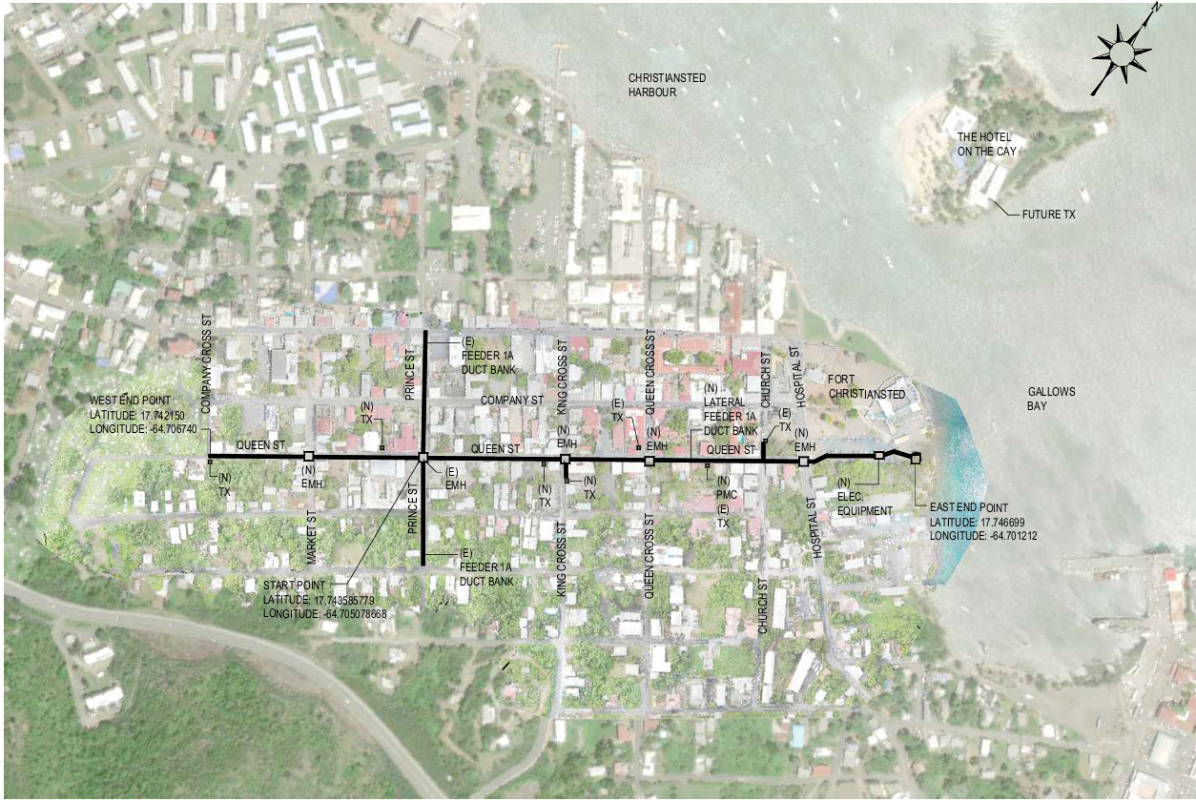
Queen Street: Project Map
Notes:
One of the first department at the Authority that electricians may interact with frequently includes personnel in the customer service department. As a representative of the Customer Service department, I would like to briefly review the departments’ roles and responsibilities regarding electrician-related services, share the different means through which electricians can contact the department and highlight where you can find our rates for the services we provide. In addition, I will also discuss some of the changes and common workflow relating to the use of the Temporary Disconnect/Reconnect Form and miscellaneous fees.

Slide 7

Queen Street: Project Timeline
Projected Construction Timeframe:
May 30, 2026 to January 1, 2027
The project will implement a block-by-block work plan. This means one block will be closed and worked on before moving onto to the next block. This plan will allow residents to have the least amount of disruption to their daily routine.
Daily Work Hours:
8 AM – 5 PM
Please note project schedule is subject to change.
Notes:
One of the first department at the Authority that electricians may interact with frequently includes personnel in the customer service department. As a representative of the Customer Service department, I would like to briefly review the departments’ roles and responsibilities regarding electrician-related services, share the different means through which electricians can contact the department and highlight where you can find our rates for the services we provide. In addition, I will also discuss some of the changes and common workflow relating to the use of the Temporary Disconnect/Reconnect Form and miscellaneous fees.

Slide 8
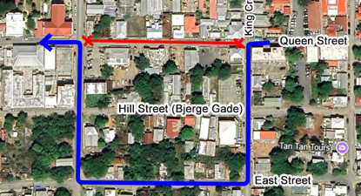
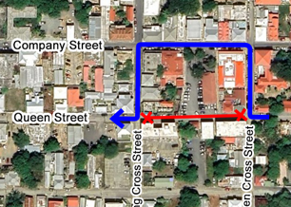
Queen Street: Traffic Control
Block by Block Work Plan
Notes:
One of the first department at the Authority that electricians may interact with frequently includes personnel in the customer service department. As a representative of the Customer Service department, I would like to briefly review the departments’ roles and responsibilities regarding electrician-related services, share the different means through which electricians can contact the department and highlight where you can find our rates for the services we provide. In addition, I will also discuss some of the changes and common workflow relating to the use of the Temporary Disconnect/Reconnect Form and miscellaneous fees.

Slide 9
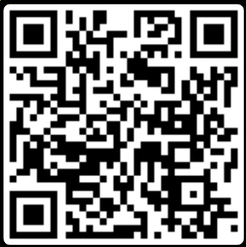
Queen Street: Service Impact & Safety
For any planned water and electrical outages, notifications will be sent out to affected customers via WAPA alerts. There will also be postings on company’s socials and website. All areas of construction will have proper safety blockades and signage.
Total Customers Impacted on Queen Street: 65
Notes:
At some point during electrician-related scope of work we recognize that you may directly or indirectly interact with personal from different departments within the Authority. The Authority’s support department includes the Customer Service Department, Design & Construction Department, System Planning Department, Automation Department/Meter Service Department /Dispatch, Line Department and the Revenue Assurance Departments. In addition, our supporting agencies include the Department of Planning and Natural Resources (DPNR) and Virgin Island Energy Office (VIEO).

Slide 10
Queen Street
Questions
Notes:
At some point during electrician-related scope of work we recognize that you may directly or indirectly interact with personal from different departments within the Authority. The Authority’s support department includes the Customer Service Department, Design & Construction Department, System Planning Department, Automation Department/Meter Service Department /Dispatch, Line Department and the Revenue Assurance Departments. In addition, our supporting agencies include the Department of Planning and Natural Resources (DPNR) and Virgin Island Energy Office (VIEO).

Slide 11




Queen Street: Contact Information
340-626-4651
communications@viwapa.vi
www.viwapa.vi/news-information/press-releases
Notes:
Our roles and responsibilities when interacting with electricians is to:
Identify, anticipate and address the needs of customers….ex
Provide information….ex Forms for service requirements
Support safe work environment….ex Handouts for Marking Properly
Provide feedback……ex
Lobby for a resolution of complaints and concerns….ex
Empower our customers….ex
Foster better relationship with stakeholders….ex

Slide 12
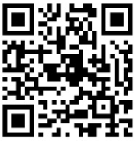
$50 Credit Available
Seeking 80 water customers to enroll in the FREE Lead and Copper testing through May 31, 2026. Customers who complete testing will receive a $50 credit on their water account!
For Survey, Scan QR Code:
*St. Croix water customers only
Notes:
Our roles and responsibilities when interacting with electricians is to:
Identify, anticipate and address the needs of customers….ex
Provide information….ex Forms for service requirements
Support safe work environment….ex Handouts for Marking Properly
Provide feedback……ex
Lobby for a resolution of complaints and concerns….ex
Empower our customers….ex
Foster better relationship with stakeholders….ex

Slide 13


